Slide 1


Containers Overview
Containers-
Overview

Slide 4
Cloud-Native Principles
Cloud-native principles apply to containers:
Isolated unit of work that does not require OS dependencies
Actively scheduled and managed by an orchestration process
Loosely coupled from any dependencies
Use microservices
Notes:
For more information, see the following references:
https://k8s.vmware.com/how-to-think-cloud-native
https://github.com/cloud-native-principles/cloud-native-principles/blob/master/cloud-native-principles.md

Slide 5
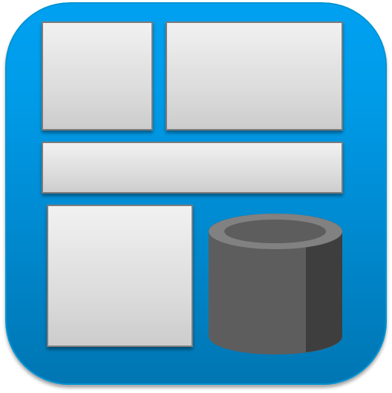
Containers and Microservices
The characteristics of containers (lightweight, easily packaged, can run anywhere) align with the goals of the microservices architecture.
Load Balancer
API Service
Web/UI
Microservice
Web/UI
Microservice
Web/UI
Microservice
Web/UI
…
Business Logic
Business Logic Microservice
Business Logic Microservice
…
Data Layer
Service
Data Layer
Microservice
Data Layer
Microservice
Data Layer
Microservice
Monolithic Application
Application as Microservices
Notes:
Containers change how applications are built.
“The microservice architectural style is an approach to developing a single application as a suite of small services, each running in its own process and communicating with lightweight mechanisms, often HTTP resource API. These services are built around business capabilities and independently deployable by fully automated deployment machinery.” -- Martin Fowler
A microservices architecture demonstrates the change from running all application functions and their dependencies wrapped inside a single monolithic OS process and segmenting that application to run in several independent components that communicate with the other components using simple standardized protocols. Because these protocols are typically Internet protocols, these new microservice components can easily migrate to other host machines.
Cattle versus pets analogy:
In a cloud computing environment, pets refer to any server that requires a human being to regularly be involved with its maintenance, like a pet owner who takes care of a pet. When a pet server is not working, a human spends time to bring it back to health. Pet servers usually have special names. Pets are individually important to the business. If (when) they fail, the business is impacted. They are often called unique snowflakes.
Cattle, on the other hand, are commodities. Many of them are running, typically to increase reliability through redundancy. They do not require names other than just a numbered identifier created by an algorithm. They are all treated the same. More (cows) can be added to provide additional capacity if demand requires it, some can be removed when their capacity is not needed, and if one stops working, it can be removed and replaced. These adjustments happen automatically with minimal human intervention. Typically, this replacement occurs without any human operator even knowing the change happened (other than discovering the event record, later, in a log).
All modern companies that intend to provide software services at scale, operate servers as cattle. When an application moves beyond the initial development phases and it is deployed at scale, it is impossible to treat its servers as pets, instead of using automation to deploy, and redeploy, them.
Microservices can be adopted gradually. For example, by providing an application programming interface (API) to an existing monolithic service, you can add new functionality with microservice components that interact with the older technological infrastructure. Over time, you can deconstruct a monolithic service layer by layer into microservices with a minimum disruption to ongoing business processes.

Slide 6
Container Benefits
Containers provide the following benefits:
Velocity
Portability
Reliability
Efficiency
Self-service
Isolation
Notes:
Containers offer the following benefits:
Velocity: Enable businesses to develop and roll out new offerings faster
Portability: Predictable execution in any Linux-based environment, from laptop to data center to the cloud
Reliability: Consistent and reproducible container image simplifies production deployments and helps decrease errors
Efficiency: Maximize resource use
Self-service: Developer productivity
Isolation: Avoid dependency conflicts

Slide 7
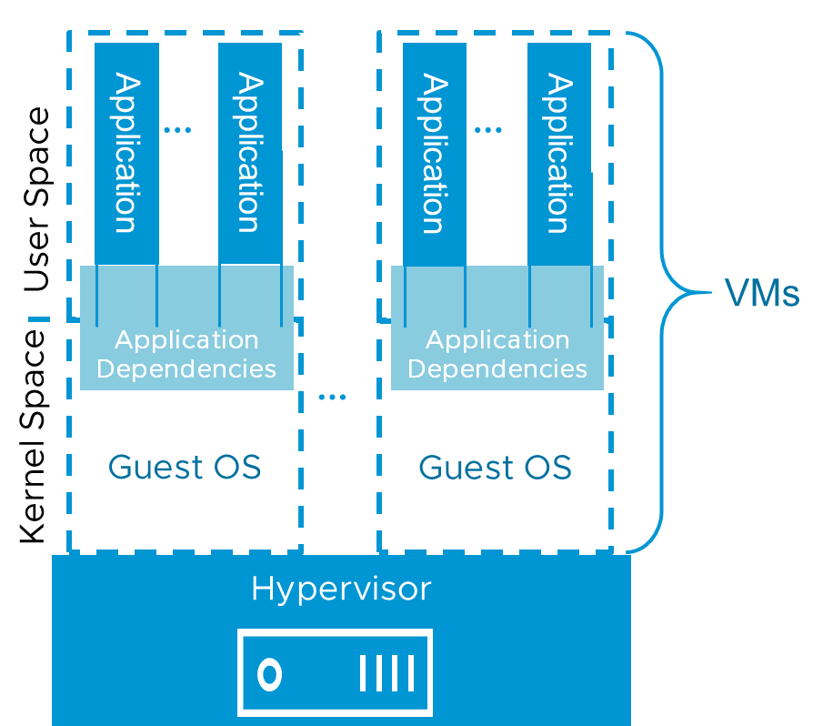
Applications in Virtual Machines at Runtime
Virtual machines encapsulate a full OS with the following components:
Running processes (such as applications)
Memory management
Device drivers
Daemons
Libraries
Notes:
Kernel space refers to the protected part of the operating system that performs such common functions as interfacing with hardware, data input and output, file system manipulations, and process runtime scheduling. The process scheduling aspect of the kernel is especially relevant to containerization.
User space (sometimes called UserLand) refers to all code that runs outside the kernel space. For example, user space is where applications reside.
Application dependencies are the various programs, daemons, libraries, and configuration data that applications use to interact with the kernel. These dependencies may reside in user space or kernel space.
By design, operating a virtualized infrastructure does not focus on managing application-level issues.

Slide 8
Applications in Containers at Runtime
Containers are the encapsulation of an application process with the application dependencies.
Containers are ultraportable. A container can run on any container host with the same operating system kernel that is specified by that container.
The word Docker is often used as a synonym for many aspects of container technologies.
Application
Application
Application Dependencies
Application Dependencies
User Space
Containers
VM
…
Guest OS
Container
Host OS
Kernel
Space
Hypervisor
Notes:
Modern container technology is evolving. Many special cases and adaptations exist beyond this introductory explanation.
The distinction between containers and VMs is that a VM at runtime encapsulates a guest operating system instance including all the processes running on that instance of the operating system, whereas a container only encapsulates a single process (and its sub-processes) with the assumption that the operating system instance was running before the container starts.
Containerization technology focuses on isolating a process from all the other processes running on the same host operating system. When you log in to a container using a remote terminal, such as SSH, you cannot see other containers running on the same host computer.
Virtualization technology begins by focusing on running multiple operating systems instances on a hypervisor.
The word Docker is often used as a synonym for many aspects of container technologies:
Docker project: The open-source software system that pioneered the use of declarative technology for the specification of containers. Much of the legacy open-source container code originated with the Docker project and still uses the term Docker.
Docker, Inc.: In 2013, dotCloud changed its name to Docker, Inc. (dotCloud was a platform as a service (PaaS) provider, where the Docker Project began).
Docker Enterprise Container Platform, for both Linux and Windows servers.
Desktop products: Docker for Windows and Docker for Mac.
Docker Hub: A repository of Docker images
Professional consulting, management services, and training classes
The Docker Project became an open-source project for the Docker Engine code and more.
The Open Container Initiative (OCI) at https://www.opencontainers.org/ began in 2017:
A Linux Foundation project
Two specifications:
Runtime specification (runtime-spec)
Image specification (image-spec)
Software components that adhere to these specifications should work together.
The Docker Engine is a client-server system that manages docker containers.
The Docker Engine is not part of the runtime of the containers.
Docker Engine includes the following components:
Docker client: Command-line interface (CLI)
Docker daemon: Responsible for the following functionalities:
Image management
REST API
Authentication
Security
Core networking
Orchestration
The Docker daemon typically runs on the same host as the containers it manages
containerd (container daemon):
Responsible for the following container life cycle operations:
STOP • REMOVE
START • PUSH
PAUSE • PULL
containerd runs alongside the containers on each container host and provides a control plane for those containers.
containerd-shim: Each running container is a child process of a unique shim:
Keeps the STDIN and STDOUT streams open. When the daemon restarts, the container does not terminate because the pipes are closed.
Reports the container exit status back to the daemon.
runc: runtime control interface (a short-lived subprocess of containerd-shim):
Creates containers
Reference implementation of the OCI runtime-spec
Small lightweight CLI wrapper for libcontainer

Slide 9
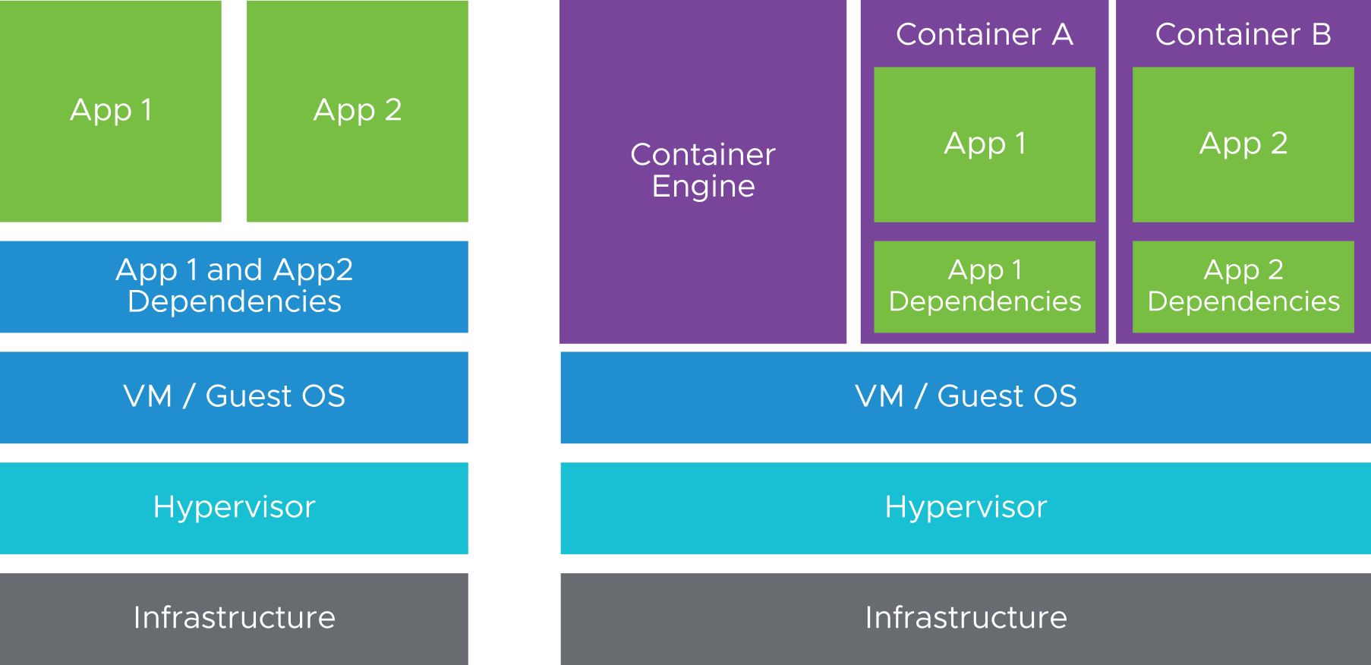
Virtual Machines and Containers (1)
Each VM provides virtual hardware that the guest OS uses to execute applications. Multiple applications run on a single physical server while still being logically separated and isolated.
With containers, developers take a streamlined base OS file system and layer on only the required binaries and libraries on which the application depends.
Notes:
With virtualization, multiple physical machines can be consolidated into a single physical machine that runs multiple virtual machines. Each VM provides virtual hardware that the guest OS uses to execute applications. Multiple applications run on a single physical service while still being logically separated and isolated.
A concern about VMs is that they are usually hundreds of megabytes to gigabytes in size, and they contain many binaries and libraries that are not relevant to the main application running on them.
With containers, developers take a streamlined base OS file system and layer on only the required binaries and libraries that the application depends on. When a container is run as a process on the container host OS, the container can see its dependencies and base OS packages. Also, the container is isolated from all other processes on the container host OS. The container processes are the only processes running on a minimal system.
From the container host OS perspective, the container is just another process that is running, but with a restricted view of the file system and potentially restricted CPU and memory.

Slide 10
Virtual Machines and Containers (2)
Compare the characteristics of virtual machines and containers.
Virtual Machines | Containers
Encapsulation of an entire operating system. | Encapsulation of an application and dependent binaries or libraries.
Scheduled by the hypervisor. | Scheduled by the container scheduler.
Run on the hypervisor. | Run on the host server.
Starting a VM means starting the virtual hardware and the operating system (seconds to minutes). | Starting a container means starting the application process (milliseconds to seconds).
Notes:
Containers are the ideal technology for microservices because the goals of containers (lightweight, easily packaged, can run anywhere) align with the goals and benefits of the microservices architecture.
Operators get modularized application components that are small and can fit into existing resources.
Developers can focus on the logic of modularized application components, knowing that the infrastructure is reliable and supports the scalability of modules.

Slide 11
Container Hosts
The container host runs the operating system on which the containers run.
Using virtual machines as container hosts has many advantages:
Flexibility
Scalability
Security
Container
Container
…
User Space
Container Host
VM
Guest OS
Kernel Space
Hypervisor
Notes:
In a containerization system, it does not matter if the container host is a physical machine or a VM hosted on a hypervisor. As the business scales up, the advantages of hosting containers on VM hosts increase.
A containerization system does not require a hypervisor. A hypervisor is significant to the underlying infrastructure.
You can use the same tools that you are familiar with for managing container hosts, but managing containers is different.
Docker is a popular system for managing containers. Docker is the subject of the next lesson.

Slide 12
About Container Hosts
Container hosts can be of the following types:
Standard OS with a container engine installed:
Ubuntu with Docker or another container engine
OS that is developed specifically with containers in mind:
Photon
CoreOS
Container hosts can be a virtual machine or a physical machine (bare metal):
Using VMs has many benefits, such as easy management and scalability.
Notes:
Operations provides container hosts as the base structure that developers use to run containers. A robust microservices system includes several deliverables, many of which are built using containers.
For developers to focus on providing services to customers, operations must provide a reliable container host infrastructure. For example, in vSphere, operations provides nonmutable vApps. The reliability of operations is increased with automated orchestration tools.

Slide 13
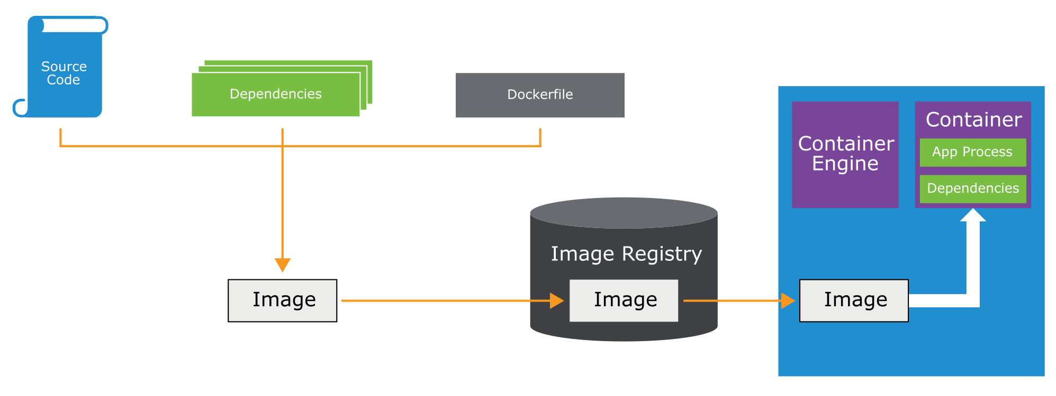
Typical Container Workflow
A container workflow includes these steps:
Build an image from the source code and dependencies.
Send the image to the image registry.
Take the image from the image registry.
Run the image as a container.
Notes:
In the example workflow, an image is created from the source code files and other dependencies. A container image can be stored in a registry, and the image can be pushed to a container host where it is used to spawn containers.
With this type of workflow, developers write code once. The code works across many different environments.
In the Dockerfile, a key specification is the name of the base OS image that is required for the container. A container can be deployed only on hosts running the OS that matches the one specified in the Dockerfile.

Slide 14
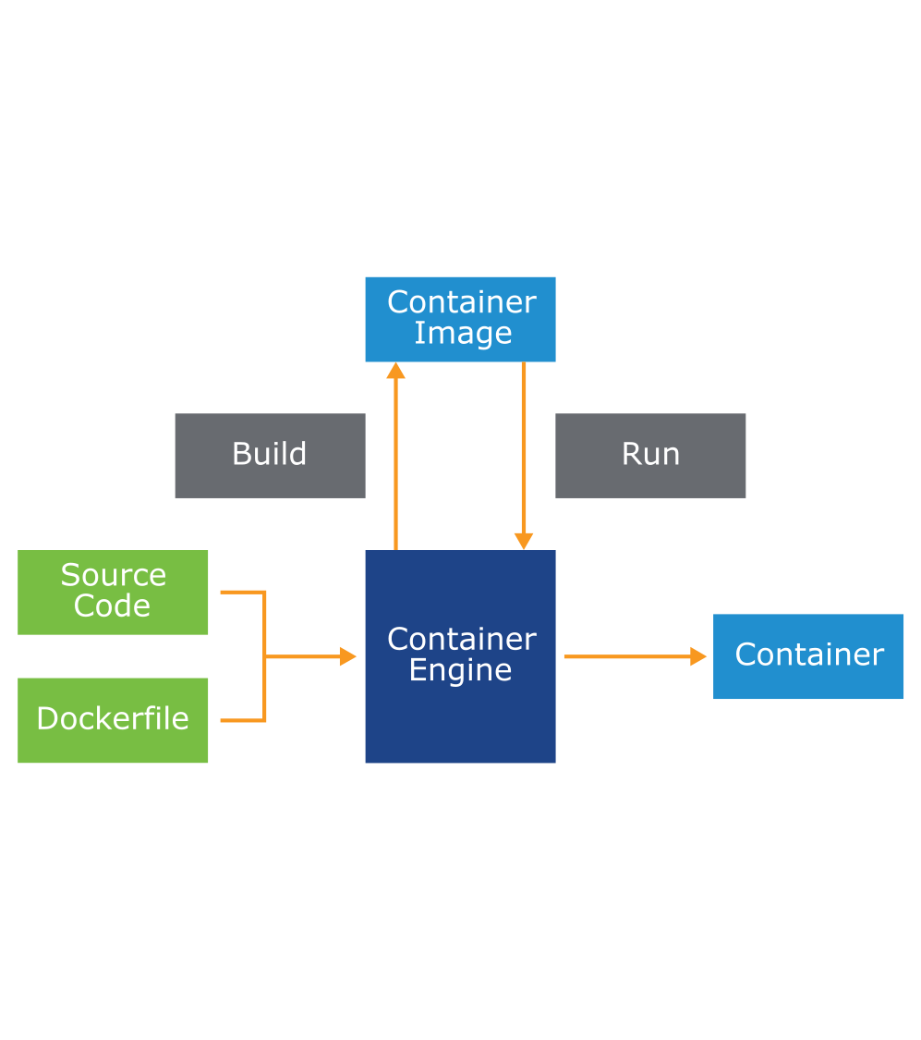
About Container Engines
A container engine is a control plane installed on each container host. It manages the containers on that host.
Container engines work in the following ways:
Build container images from the source code (for example, Dockerfile).
Alternatively, start container images from a repository.
Create running containers based on a container image.
Commit a running container to an image.
Save an image and push it to a repository.
Stop and remove containers.
Suspend and restart containers.
Report container status.
Notes:
The container engine runs as a daemon process on the container host OS. When a user requests that a container is run, the container engine gets the container image from an image registry (or locally if already downloaded) and runs the container as a process. Docker is the most commonly used container engine.

Slide 15
The Dockerfile and Programmatic Construction
VM creation is not guaranteed to be scripted or reproducible.
Dockerfile is a plaintext file that clearly defines each stage that is required to build a container image.
Dockerfile produces a consistent and reproducible container image
You run the docker build command to create an image from Dockerfile.
You run the docker run command to create and start a container.
FROM ubuntu:18.04
RUN apt-get update && apt-get install -y php=8.0.8 nginx=1.20.1
COPY ./index.php /var/www/html/index.php
EXPOSE 80
CMD ["/var/www/html/index.php", "-D", "FOREGROUND"]

Slide 16
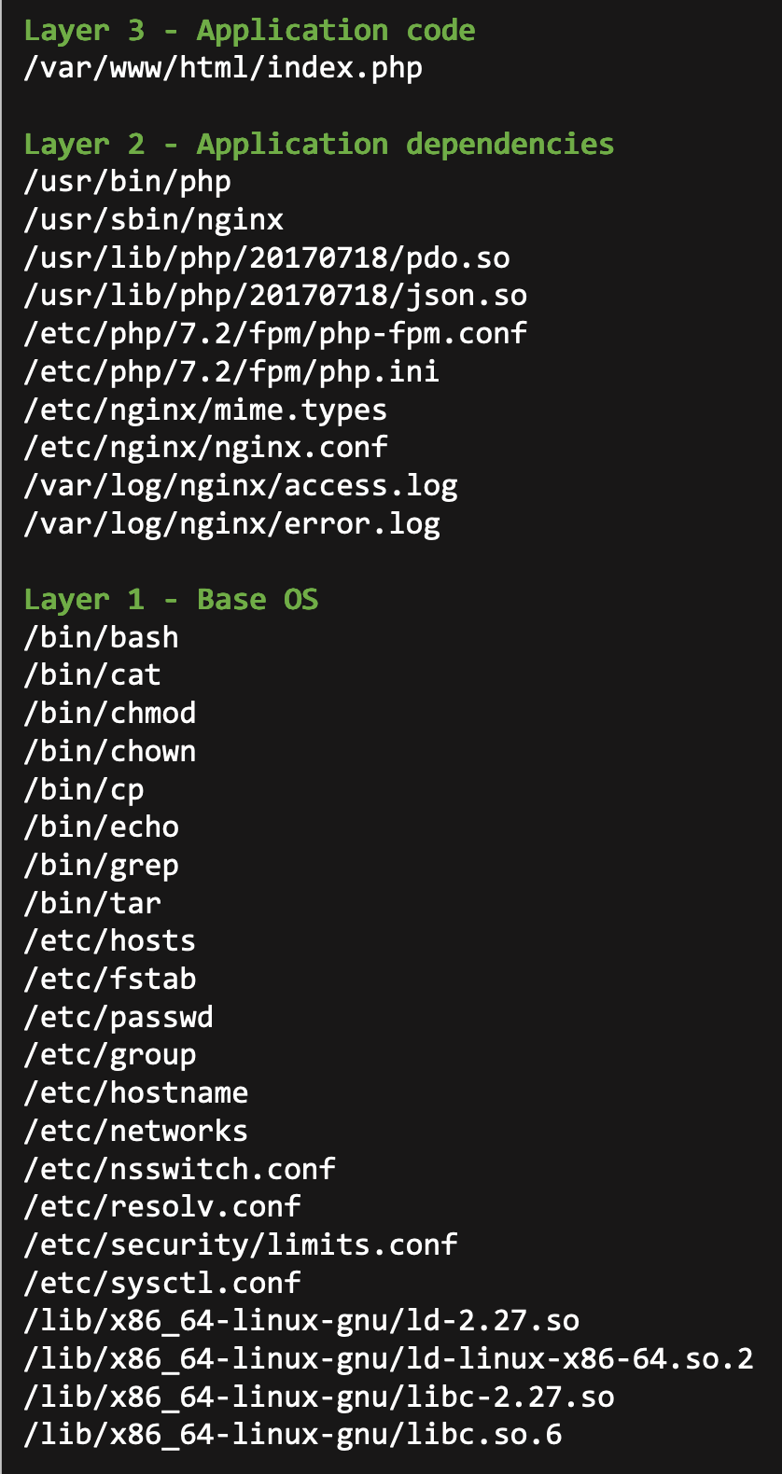
Container Images
An image is effectively a stopped container that is loaded on the container host. An image is like a VM snapshot.
Images are stored to and retrieved from an image repository server.
They contain application code and application dependencies:
Do not contain kernel or device drivers.
Are built using a layered file system, for example:
Layer 1: Base OS layer, including typically low-level OS libraries.
Each subsequent layer stores additional components as defined in the Dockerfile.
Layer 2: Application-specific dependencies, such as NGINX web server and PHP runtime.
Layer 3: Application code, such as index.php.
Notes:
Docker uses a union file system to combine multiple layers into a single image. These layers (also called intermediate images) are generated when the commands in the Dockerfile are run during the Docker image build. The intermediate images are layered together to form a new single coherent directory of files that makes up the image on the container host.
To analyze a Docker image, run these commands:
docker image inspect
docker image history

Slide 17

Images and Containers
An image is the result of a build.
A container is a running instance from an image.
$ docker | images
php |  | latest | 8c811b4aec35 | 2 | weeks | ago
mysql |  | latest | a8a59477268d | 4 | weeks | ago
1.15 MB
445 MB
445 MB
foo.com/mysql
latest
a8a59477268d
4 weeks ago
$ docker ps
CONTAINER ID | IMAGE | COMMAND | CREATED |  | STATUS |  | PORTS | NAMES
Acc5c8f58392 | mysql | “mysqld” | About a minute | ago | Up About | a minute | 3306/tcp | myWebsiteDB

Slide 18
Starting and Stopping Containers
You run the following commands to start and stop containers:
docker run: Starts a new container from an image
docker stop: Stops a running container
docker rm:
Deletes a container (must be stopped)
Add -f to both stop and remove a container

Slide 19
Managing Images
The following commands help to manage images:
docker images: Displays a list of images on the machine
docker rmi: Deletes an image
docker build: Builds an image from a Dockerfile
docker tag: Adds tags to an image
docker pull and docker push: Pulls and pushes images to and from a registry

Slide 20
Additional Docker Commands
You might run these additional commands when working with images:
docker ps:
Retrieves a list of running containers
Add -a to include non-running containers
docker logs: Displays a container’s log output
docker exec:
Runs a command within a container
Can also start a shell within a container (if available)
docker network: Creates a network

Slide 21
Container Registry
A container registry provides a central location for container image storage.
Types of registries include hosted and self-hosted:
Hosted: Docker Hub, Google Container Registry
Self-hosted: Artifactory, Harbor, Quay
Container registries can be public or private.
Images are built on a build host and pushed to a registry.

Slide 22

Project Harbor
Harbor is an open-source enterprise-class registry server. It is integrated into many VMware products.
Harbor includes the following features:
Identity integration and role-based access control (RBAC)
Security vulnerability scanning (Clair or Trivy)
Content trust and image signing (Notary)
Policy-based image replication
Helm chart management
Notes:
Harbor was created by VMware in 2014, shared with the community through an open-source license in 2016, and accepted by the Cloud Native Computing Foundation (CNCF) in 2018.
Harbor was accepted as the first container registry by the CNCF sandbox in July 2018 and to the CNCF Incubator in November 2018.
Harbor provides the following features:
Replicate projects: Harbor supports image replication to replicate repositories from one Harbor instance to another.
Manage roles by the Lightweight Directory Access Protocol (LDAP) group: Harbor administrators can import an LDAP or Active Directory (AD) group to Harbor and assign project roles to it.
Manage labels: Harbor provides labels to isolate image resources globally or at the project level.
Manage helm charts: Harbor provides management of helm charts isolated by projects and controlled by role-based access control (RBAC).
Integrated UAA authentication: Harbor can share UAA authentication with PAS and VMware PKS.
RBAC: Users and repositories are organized into projects. Users can have different permissions for the images in different projects.
Policy-based image replication: Images can be synchronized between multiple registry instances with autoretry on errors, offering support for load balancing, high availability, multidata center, hybrid, and multicloud scenarios.
Vulnerability scanning: Harbor uses CoreOS Clair to scan images regularly and warn users about vulnerabilities.
LDAP or AD support: Harbor integrates with enterprise LDAP or AD systems for user authentication and management.
Image deletion and garbage collection: Images can be deleted and their space can be reused.
Notary: Image authenticity can be ensured by using Docker Notary.
Graphical user portal: Users can easily browse, search repositories, and manage projects.
Auditing: All operations to repositories are tracked.
RESTful API: RESTful APIs are available for most administrative operations and are easy to integrate with external systems.
For more information about Harbor version 1.6.0, see the Harbor website at https://goharbor.io/blogs/harbor-1.6.0-release/.
.

Slide 23
Additional References
Title | Location
Container 101 for the vSphere Admin | https://www.youtube.com/watch?v=NeJ20lbzv0c
Google: 'EVERYTHING at Google runs in a container' | https://www.theregister.co.uk/2014/05/23/google_containerization_two_billion/
What is a Container? | https://www.youtube.com/watch?v=EnJ7qX9fkcU
The History of Container Technology | https://linuxacademy.com/blog/containers/history-of-container-technology/
A Brief History of Containers: From the 1970s to 2017 | https://blog.aquasec.com/a-brief-history-of-containers-from-1970s-chroot-to-docker-2016
Container vs. Process | https://sites.google.com/site/mytechnicalcollection/cloud-computing/docker/container-vs-process
Container vs. VM | https://sites.google.com/site/mytechnicalcollection/cloud-computing/docker/container-vs-vm

Slide 24
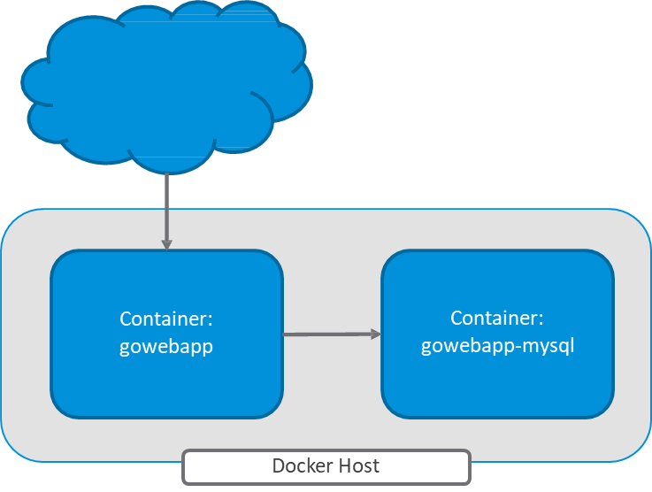
Deploying the Go Web Application Using Docker
Go Web App is a web–based notepad application:
The front end is written in Golang.
The back end is MySQL database.

